Slide 1


模拟电子技术基础
Analog Device
9 Signal Generation
信号的产生
陈晓龙 Chen, Xiaolong
电子与电气工程系 E³

Slide 2
9.0 Signal generation
Sine-wave/sinusoidal oscillator/generator
正弦波振荡器
Non-Sine-wave/Non-sinusoidal oscillator/generator
非正弦波振荡器

Slide 3






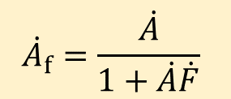

9.1 Sine-wave oscillator
(1) Self-excited oscillation in negative feedback circuits负反馈电路中的自激振荡
Open-loop gain
+
Feedback factor
Close-loop gain

Slide 4
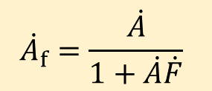





Close-loop gain
Self-excited oscillation 自激振荡:
There is output AC signal when no input AC signal.

Slide 5




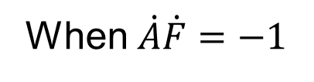


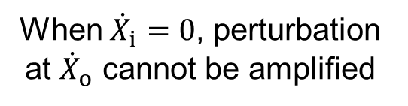
Self-excited oscillation 自激振荡:
+

Slide 6














Start-oscillation condition起振条件:
Perturbation signal can be amplified
Positive feedback
+

Slide 7











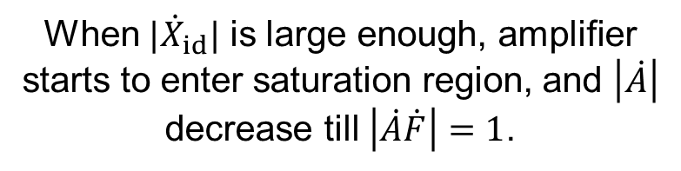
+
This is the self-excited oscillation

Slide 8






When oscillation is stable:
+
Start-oscillation condition起振条件:

Slide 9
Drawbacks of self-excited oscillation in negative feedback circuits:
Oscillation frequency cannot be well controlled.
Solutions: use positive feedback circuits

Slide 10










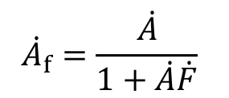

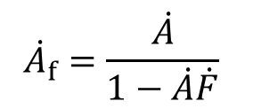


Negative feedback
Positive feedback
+
+

Slide 11


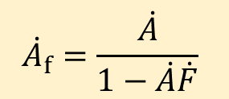





(2) Positive feedback circuits 正反馈电路中的自激振荡
+
When oscillation is stable:

Slide 12



When oscillation is stable:
Start-oscillation condition起振条件:

Slide 13

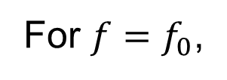


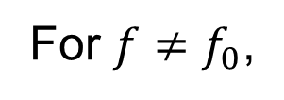

How to control oscillation frequency f₀?
Frequency selection network 选频网络
Band pass filter 带通滤波

Slide 14
Sine-wave oscillator contains:
Amplifier circuit 放大电路
Positive feedback network 正反馈网络
Can be combined!合二为一
Frequency selection network 选频网络
Amplitude stabilization link 稳幅环节
Use the non-linear characteristic of electronic devices

Slide 15
Sine-wave oscillator types:
RC sine-wave oscillator
LC sine-wave oscillator
Crystal oscillator 晶体振荡器

Slide 16













9.2 RC sine-wave oscillator
Wien bridge oscillator 文氏电桥振荡器
Negative feedback
Amplifier circuit
Positive feedback + Frequency selection

Slide 17
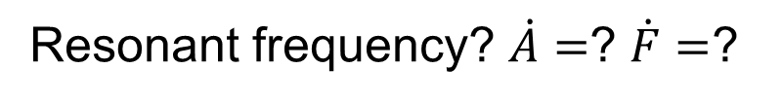
Separation method 分离法
Amplifier circuit
Positive feedback + Frequency selection

Slide 18
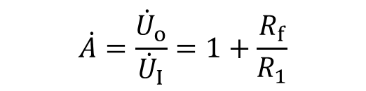


Amplifier circuit

Slide 19

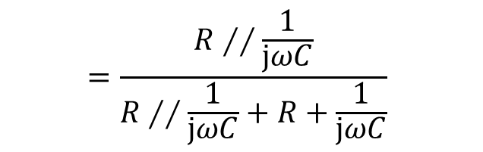



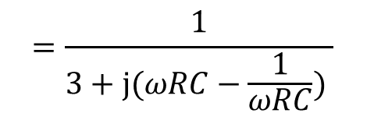



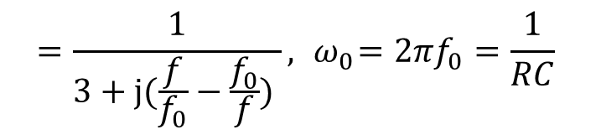
Frequency selection network

Slide 20
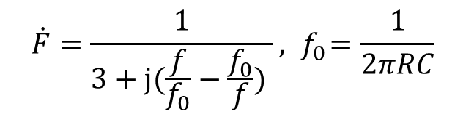
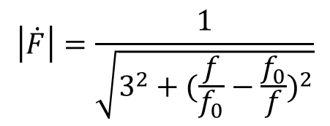
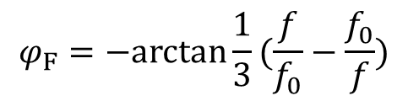
Frequency selection network
Amplitude-frequency characteristic
Phase-frequency characteristic

Slide 21
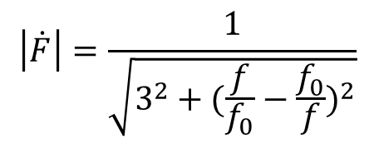










Frequency selection network
Amplitude-frequency characteristic

Slide 22


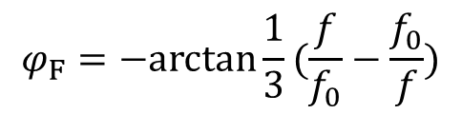














Frequency selection network
Phase-frequency characteristic

Slide 23






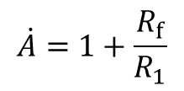







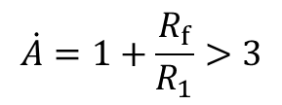
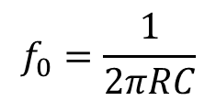
Working principle:
Amplifier circuit
Oscillation starts!
(b) Oscillation frequency:

Slide 24





Working principle:
Amplifier circuit
No self-excited oscillation!

Slide 25

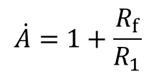


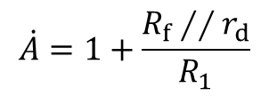











Amplitude stabilization 稳幅措施
(1) Use two diodes!

Slide 26
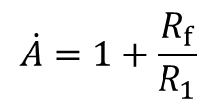






Amplitude stabilization 稳幅措施
(2) Use thermistor 热敏电阻!
Negative TC 负温度系数
Positive TC 正温度系数

Slide 27





9.3 LC sine-wave oscillator
Use inductor and capacitor as frequency selection network
(1) Inductor and capacitor in parallel connection
Ideal case
Real case

Slide 28
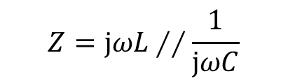
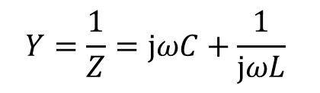


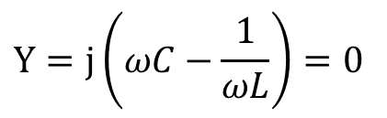


Impedance 阻抗
Ideal case
Admittance 导纳
Resonant frequency: Imaginary part of Y is zero 共振频率:导纳虚部为0。
Variable resistor

Slide 29
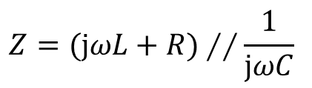

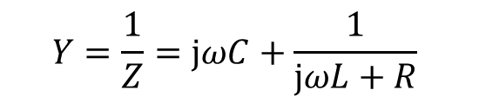


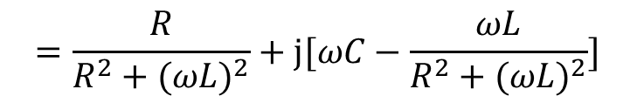
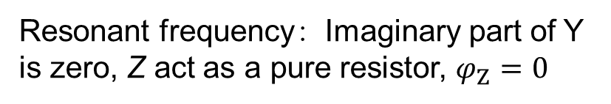
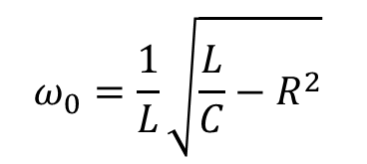
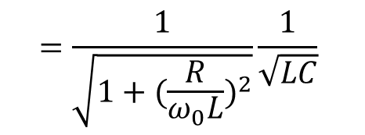
Real case
Impedance 阻抗

Slide 30
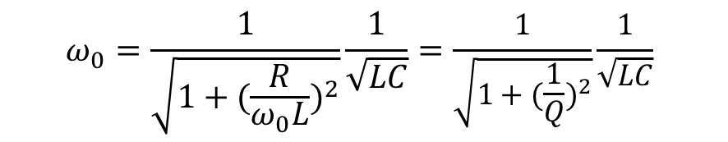
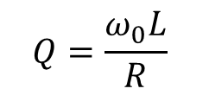
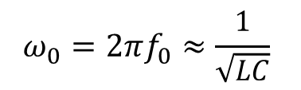

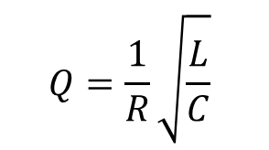
Real case
: the quality factor

Slide 31

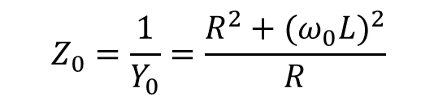







Real case
Impedance :
Act as a pure resistor 等效为纯电阻

Slide 32








Real case
Large Q
Small Q
Lager Q, better selectivity!

Slide 33

























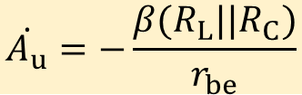
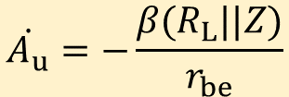
Amplifier circuit with LC frequency selection network
Z
c
c
T
T
b
b
e
e

Slide 34



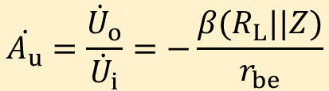



















Amplifier circuit with LC frequency selection network
c
T
b
e

Slide 35











(2) Transformer feedback LC oscillator 变压器反馈式LC振荡电路
Feedback network?
T
Positive or negative for AC circuit?

Slide 36







AC circuit
T
T

Slide 37











Instantaneous polarity method瞬时极性法
T

Slide 38


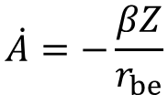




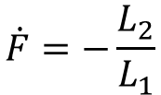



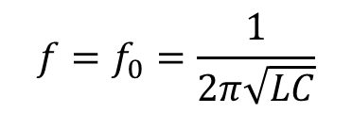
Ignore mutual inductance between L1 and L2 忽略互感
Start-oscillation condition:起振条件
T
Oscillation frequency:

Slide 39











Merits:
Liable to generate oscillation
High oscillation frequency
T
High quality of output waveform
Drawback:
Power loss is high

Slide 40











(3) Hartley feedback oscillator 电感反馈式/三点式振荡电路
Positive or negative for AC circuit?
T

Slide 41




















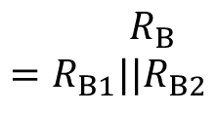


Positive or negative for AC circuit?
AC circuit
T
T

Slide 42
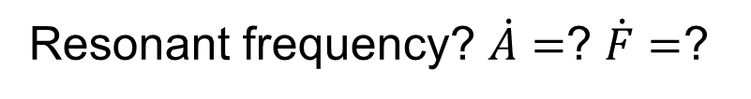










AC circuit
T
T

Slide 43
















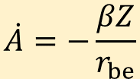
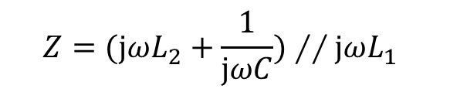




Ignore mutual inductance between L1 and L2 为了简略忽略互感（实际情况是一定要考虑互感）
Inductor: R→0
T
T
Voltage gain:
Resonant frequency:

Slide 44











Positive feedback network:
T
T

Slide 45















Start-oscillation condition起振条件:
T
At resonant frequency:

Slide 46










(3) Colpitts feedback oscillator 电容反馈式/三点式振荡电路
Positive or negative for AC circuit?
T

Slide 47




















Positive or negative for AC circuit?
T
T
T

Slide 48














Positive or negative for AC circuit?
T

Slide 49


















T
Voltage gain:
Resonant frequency:

Slide 50
















Positive feedback network:
T

Slide 51












Start-oscillation condition:
T
At resonant frequency:

Slide 52
9.4 Quartz crystal oscillator 石英晶体振荡器
Quartz: SiO₂ crystal 二氧化硅晶体
Crystalline anisotropy 晶体各向异性
Piezoelectric effect 压电效应
Piezoelectric effect:
Apply an electric field across quartz, there will be mechanical deformation.
Apply a mechanical force across quartz, there will be electric field.

Slide 53
Piezoelectric vibration 压电振荡
Metal
1) Apply a AC voltage across quartz;
Quartz
2) Mechanical vibration in quartz;
Metal
The amplitude of mechanical vibration is small
3) When AC voltage frequency equals to the intrinsic frequency of quartz.
4) The amplitude of vibration is very large, oscillation is resonant.
Intrinsic frequency: 固有频率，is also called resonant frequency 共振频率

Slide 54
Electronic circuit symbol
Metal
Quartz
Metal

Slide 55








Equivalent circuit 等效电路

Slide 56








Equivalent circuit 等效电路

Slide 57









Equivalent circuit 等效电路

Slide 58



Frequency response of impedance
Ignore R: R=0

Slide 59




Frequency response of impedance
Series resonance 串联谐振
Series resonant frequency:

Slide 60




Frequency response of impedance
Parallel resonance 并联谐振
Parallel resonant frequency:

Slide 61











Frequency response of impedance

Slide 62




Quartz oscillator circuit
(a) Parallel type
(b) Series type
Question 1: Quartz works at which region?
Question 1: Quartz works at which region?
Question 2: Which type oscillator?

Slide 63
Homework：refer to blackboard

